Slide 1
Vector Space Model
Dr Georgina Cosma

Slide 2
Outline
Why ranked retrieval?
Term frequency
tf-idf weighting
Vector Space Model

Slide 3
Binary → count → weight matrix
 | Anthony and Cleopatra | Julius Caesar | The Tempest | Hamlet | Othello | Macbeth . . .
ANTHONY BRUTUS CAESAR CALPURNIA CLEOPATRA MERCY WORSER . . . | 5.25 1.21 8.59 0.0 2.85 1.51 1.37 | 3.18 6.10 2.54 1.54 0.0 0.0 0.0 | 0.0 0.0 0.0 0.0 0.0 1.90 0.11 | 0.0 1.0 1.51 0.0 0.0 0.12 4.15 | 0.0 0.0 0.25 0.0 0.0 5.25 0.25 | 0.35 0.0 0.0 0.0 0.0 0.88 1.95
Tf is the local term frequency (local frequency) (i.e. Number of times t appears in doc d)
Idf is the global frequency of a term across a document collection) (i.e. Number of times t appears in document collection C)
Each document is now represented as a real-valued vector of tf-idf weights ∈ R^{|V|.}
We have previously discussed how to calculate tf-idf
‹#›
Notes:
In mathematics, a real number is a value of a continuous quantity that can represent a distance along a line.
Tf is the term frequency (local frequency)
Idf is the global frequency of a term across a document collection.

Slide 4
Binary → count → weight matrix
 | Anthony and Cleopatra | Julius Caesar | The Tempest | Hamlet | Othello | Macbeth . . .
ANTHONY BRUTUS CAESAR CALPURNIA CLEOPATRA MERCY WORSER . . . | 5.25 1.21 8.59 0.0 2.85 1.51 1.37 | 3.18 6.10 2.54 1.54 0.0 0.0 0.0 | 0.0 0.0 0.0 0.0 0.0 1.90 0.11 | 0.0 1.0 1.51 0.0 0.0 0.12 4.15 | 0.0 0.0 0.25 0.0 0.0 5.25 0.25 | 0.35 0.0 0.0 0.0 0.0 0.88 1.95
Tf is the local term frequency (local frequency) (i.e. Number of times t appears in doc d)
Idf is the global frequency of a term across a document collection. ) (i.e. Number of times t appears in document collection C)
Each document is now represented as a real-valued vector of tf-idf weights ∈ R^{|V|.}
We have previously discussed how to calculate tf-idf
‹#›
Notes:
Tf is the term frequency (local frequency)
Idf is the global frequency of a term across a document collection.

Slide 5
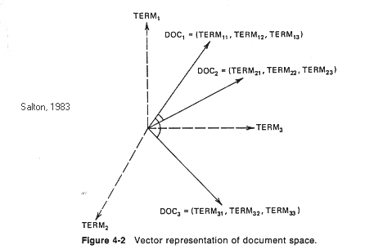
Documents as vectors
Each document is now represented as a real-valued vector of tf-idf weights ∈ R^{|V|.}
So we have a |V|-dimensional real-valued vector space.
Terms are axes of the space.
Documents are points or vectors in this space.
Very high-dimensional: tens of millions of dimensions when you apply this to web search engines
Each vector is very sparse – most entries
are zero.
 | Anthony and Cleopatra | Julius Caesar | The Tempest | Hamlet | Othello | Macbeth . . .
ANTHONY BRUTUS CAESAR CALPURNIA CLEOPATRA MERCY WORSER . . . | 5.25 1.21 8.59 0.0 2.85 1.51 1.37 | 3.18 6.10 2.54 1.54 0.0 0.0 0.0 | 0.0 0.0 0.0 0.0 0.0 1.90 0.11 | 0.0 1.0 1.51 0.0 0.0 0.12 4.15 | 0.0 0.0 0.25 0.0 0.0 5.25 0.25 | 0.35 0.0 0.0 0.0 0.0 0.88 1.95
‹#›
Notes:
Each document is now represented as a real-valued vector of tf-idf weights ∈ R^{|V|.}
So we have a |V|-dimensional real-valued vector space.
Terms are axes of the space.
Documents are points or vectors in this space.
Very high-dimensional: tens of millions of dimensions when you apply this to web search engines
Each vector is very sparse - most entries are zero. We have already discussed the inverted index as a strategy for dealing with sparsity. In the next session we will also discuss sparsity when we go through Latent Semantic Indexing.

Slide 6
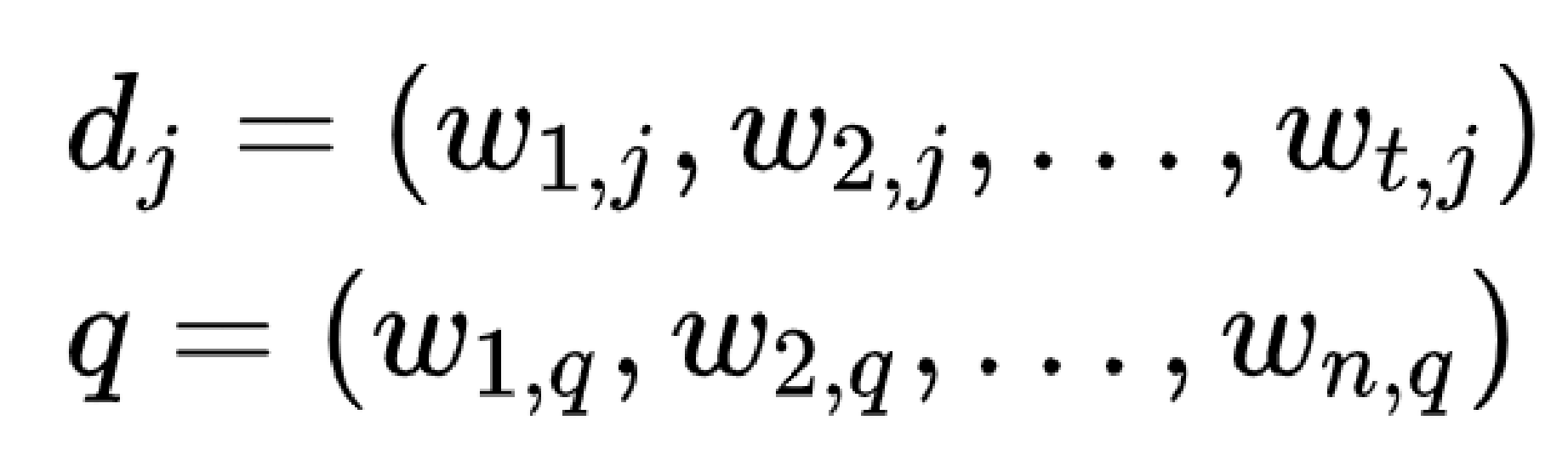
Documents as vectors
 | Anthony and Cleopatra | Julius Caesar
ANTHONY BRUTUS CAESAR CALPURNIA CLEOPATRA MERCY WORSER . . . | 5.25 1.21 8.59 0.0 2.85 1.51 1.37 | 3.18 6.10 2.54 1.54 0.0 0.0 0.0
Documents and queries are represented
as vectors.
Each dimension corresponds to a separate term.
If a term occurs in the document, its value in the vector is non-zero.
Term weighting can be applied tf-idf weighting (we covered this).
The definition of term depends on the application. Typically terms are single words, keywords, or longer phrases. If words are chosen to be the terms, the dimensionality of the vector is the number of words in the vocabulary (the number of distinct words occurring in the corpus).
Vector operations can be used to compare documents with queries.
w(i,j)
 | Anthony and Cleopatra | Julius Caesar
ANTHONY BRUTUS CAESAR CALPURNIA CLEOPATRA MERCY WORSER . . . | w(1,1) w(2,1) w(3,1) w(4,1) w(5,1) w(6,1) w(7,1) w(8,1) | w(1,2) w(2,2) w(3,2) w(4,2) w(5,2) w(6,2) w(7,2) w(8,2)
Notes:
Each dimension corresponds to a separate term.
If a term occurs in the document, its value in the vector is non-zero.
Several different ways of computing these values, also known as
(term) weights, have been developed.
One of the best known schemes is tf-idf weighting (we covered this).
The definition of term depends on the application.
Typically terms are single words, keywords, or longer phrases. If words are chosen to be the terms, the dimensionality of the vector is the number of words in the vocabulary (the number of distinct words occurring in the corpus).
Vector operations can be used to compare documents with queries.

Slide 7
Documents as vectors
 | Anthony and Cleopatra | Julius Caesar
ANTHONY BRUTUS CAESAR CALPURNIA CLEOPATRA MERCY WORSER . . . | 5.25 1.21 8.59 0.0 2.85 1.51 1.37 | 3.18 6.10 2.54 1.54 0.0 0.0 0.0
Documents and queries are represented
as vectors.
w(i,j)
 | Anthony and Cleopatra | Julius Caesar
ANTHONY BRUTUS CAESAR CALPURNIA CLEOPATRA MERCY WORSER . . . | w(1,1) w(2,1) w(3,1) w(4,1) w(5,1) w(6,1) w(7,1) w(8,1) | w(1,2) w(2,2) w(3,2) w(4,2) w(5,2) w(6,2) w(7,2) w(8,2)
Index of the term t
Index of the document j

Slide 8
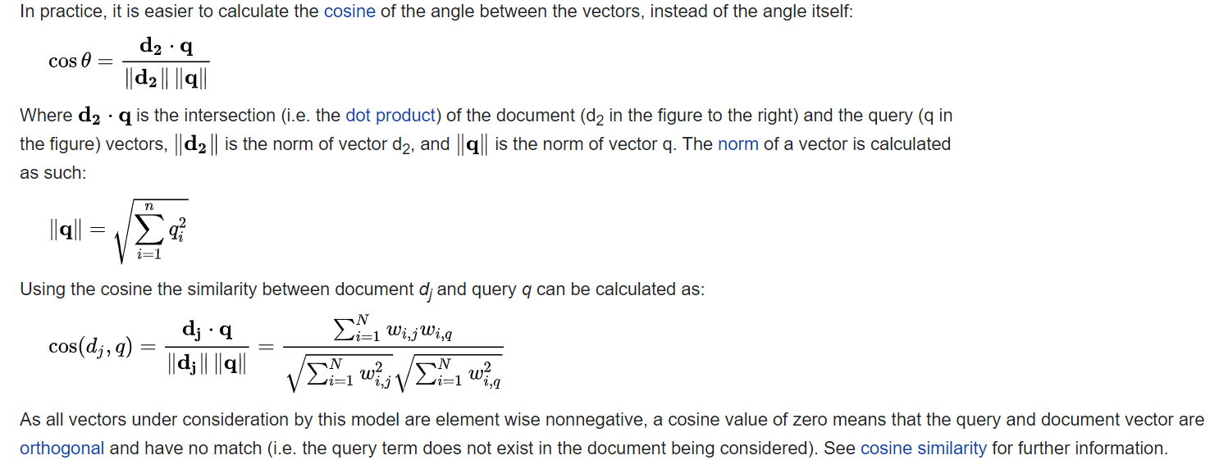
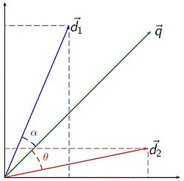
Documents as vectors
The original query can be represented as a query vector with same dimension as the vectors that represent the other documents. The query is treated as another document vector with term weights corresponding to each term in the corpus (document collection dictionary). Then the similarity between the query vector q and all other documents can be calculated.
The Euclidean norm (also called the vector magnitude, Euclidean length, or 2-norm) of a vector q with n elements
Notes:
The original query can be represented as a query vector with same dimension as the vectors that represent the other documents. In essence the query is treated as another document vector with term weights corresponding to each word in the corpus (document collection dictionary). Then the similarity between the query vector q and all other documents can be calculated.
The Euclidean norm (also called the vector magnitude, Euclidean length, or 2-norm) of a vector v with N elements is defined by

Slide 9
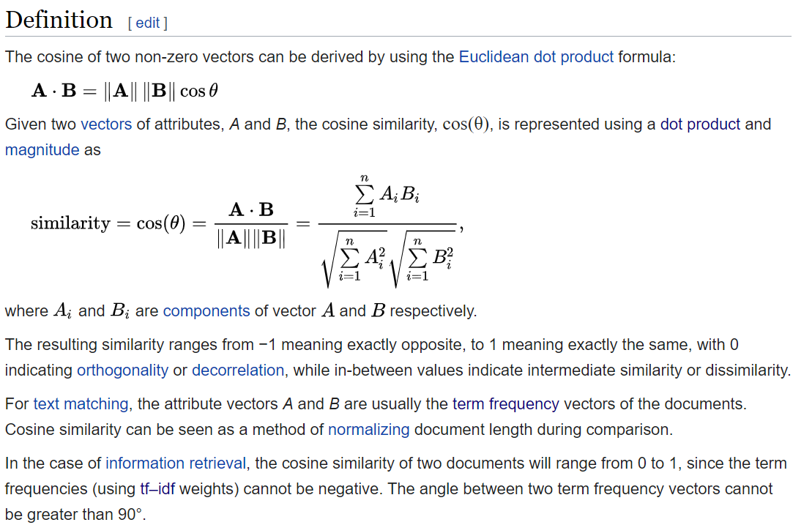
Dot product
magnitude
Notes:
Wikepedia.com

Slide 10
Queries as vectors
1. Represent queries vectors in the high-dimensional space, in the same way as we do with documents.
2. Rank documents according to their proximity to the query
proximity = similarity
proximity ≈ negative distance
We’re doing this because we want to get away from the you’re-either-in-or-out Boolean model.
Instead: rank relevant documents higher than non-relevant documents
‹#›
Notes:
Key idea 1: do the same for queries as we do with documents: represent them as vectors in the high-dimensional space
Key idea 2: Rank documents according to their proximity to the query
proximity = similarity
proximity ≈ negative distance
Recall: We’re doing this because we want to get away from the you’re-either-in-or-out, feast-or-famine Boolean model.
Instead: rank relevant documents higher than non-relevant documents
Proximity = similarity: This suggests that the "closeness" or "proximity" of documents to the query is determined by their similarity to the query. In this context, similarity can be understood as how closely the content of a document matches the intent or the specific terms of the query. Documents that are more similar to the query are considered to be in closer proximity to it.
Proximity ≈ negative distance: This part elaborates on how proximity (or similarity) is quantified. It suggests that proximity can be thought of as the negative of distance, implying that as the distance between the query and a document decreases (meaning they are more alike), their proximity (or similarity) increases. In mathematical terms, a smaller distance equals a higher similarity score.
This concept is fundamental in many search algorithms and machine learning models that deal with text data. They often calculate a "distance" metric between the query and potential result documents using various algorithms (like cosine similarity, Euclidean distance, etc.). The idea is to then rank these documents in order of decreasing similarity (or increasing proximity) to the query, with the assumption that documents more similar to the query are more relevant to the user's needs.
In practical terms, when you perform a search on a search engine or a database, the system uses these principles to decide which documents to show you first. It calculates how "close" each document is to your search terms and ranks them accordingly, so you see the most relevant results at the top of the list.

Slide 11
Proximity = similarity: the "closeness" or "proximity" of documents to the query is determined by their similarity to the query. In this context, similarity can be understood as how closely the content of a document matches the intent or the specific terms of the query. Documents that are more similar to the query are considered to be in closer proximity to it.
Proximity ≈ negative distance: this is how proximity (or similarity) is quantified. It suggests that proximity can be thought of as the negative of distance, implying that as the distance between the query and a document decreases (meaning they are more alike), their proximity (or similarity) increases. In mathematical terms, a smaller distance equals a higher similarity score.
Notes:
for example the smaller the angle, or euclidean distance the closer the query and document are.

Slide 12
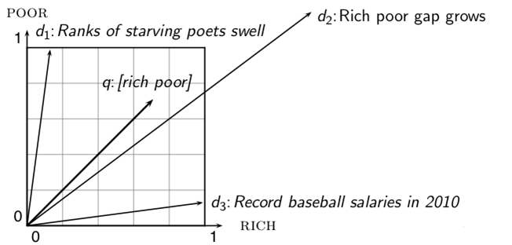
Why distance is a bad idea
The Euclidean distance of and is large although the distribution of terms in the query q
and the distribution of terms in the document d₂ are very similar.
‹#›

Slide 13
Cosine similarity is a measure of similarity between two non-zero vectors of an inner product space.
It is defined to equal the cosine of the angle between them, which is also the same as the inner product of the same vectors normalised to both have length 1.

Slide 14
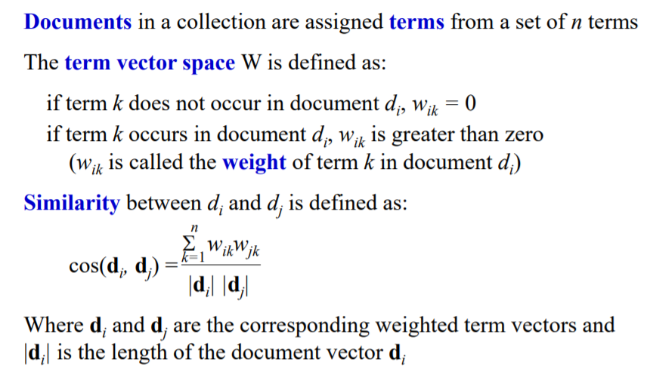
Vector similarity computation with weights
(recap you can skip if you wish)

Slide 15
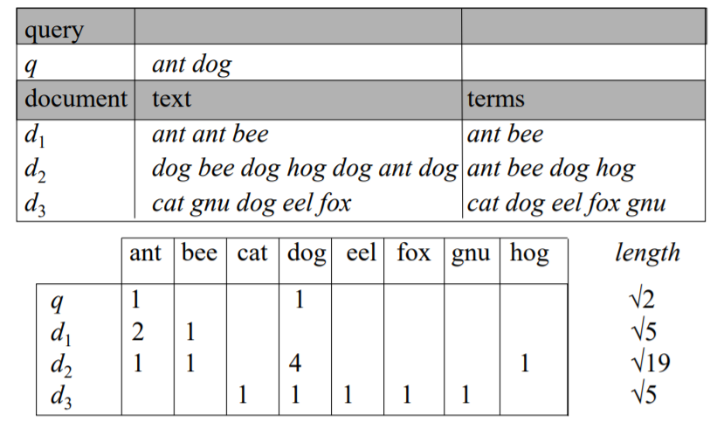
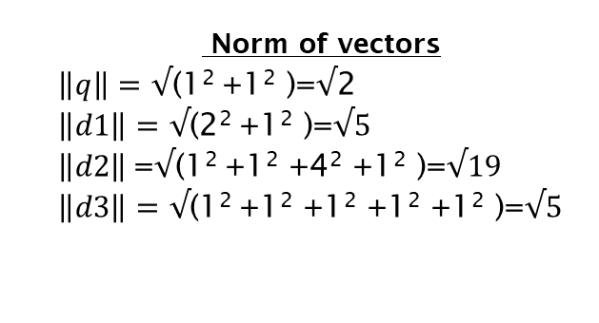
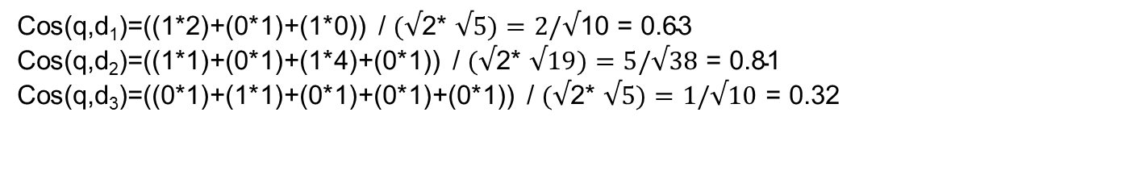
Simple Example of Ranking (Weighting by Term Frequency) – Putting it all together

Slide 16
Part II: Computing vector similarity for normalised vectors

Slide 17


Vector length normalization
How do we compute the cosine document length normalization?
A vector can be (length-) normalized by dividing each of its components by its length – here we use the L₂ norm:
This maps vectors onto the unit sphere . . .
. . . since after normalization:
As a result, longer documents and shorter documents have weights of the same order of magnitude.
‹#›
Notes:
Document length normalization adjusts the term frequency or the relevance score in order to normalize the effect of document length on the document ranking.

Slide 18

Cosine similarity for normalized vectors
IMPORTANT
For normalized vectors, the cosine is equivalent to the dot product or scalar product.
(if and are length-normalized).
‹#›

Slide 19
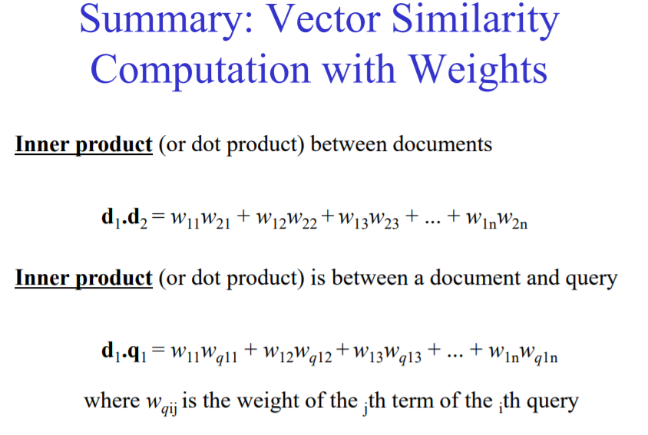
Vector similarity computation with weights
The dot product may be defined algebraically or geometrically. The geometric definition is based on the notions of angle and distance (magnitude of vectors).
 | Anthony and Cleopatra | Julius Caesar
ANTHONY BRUTUS CAESAR CALPURNIA CLEOPATRA MERCY WORSER . . . | 5.25 1.21 8.59 0.0 2.85 1.51 1.37 | 3.18 6.10 2.54 1.54 0.0 0.0 0.0
 | Anthony and Cleopatra | Julius Caesar
ANTHONY BRUTUS CAESAR CALPURNIA CLEOPATRA MERCY WORSER . . . | w(1,1) w(2,1) w(3,1) w(4,1) w(5,1) w(6,1) w(7,1) w(8,1) | w(1,2) w(2,2) w(3,2) w(4,2) w(5,2) w(6,2) w(7,2) w(8,2)
d1.d2=(5.25*3.18)+(1.21*6.10)+…
Document 1 term 1
Document 2 term 1
Document 1 term 2
Notes:
This slides shows the vector similarity between two documents d1 and d2.
The inner product between two documents is computed by multiplying two vectors together, as shown in the formula. So, the term Anthony has a value of 5.25 in document Anthony and Cleopatra and a weight of 3.18 in Julius Caesar. We start by multiplying those values

Slide 20
Cosine similarity example with normalised vectors
term frequencies (counts)
How similar are these novels?
SaS: Sense and Sensibility
PaP: Pride and Prejudice
WH: Wuthering Heights
term | SaS | PaP | WH
AFFECTION JEALOUS GOSSIP WUTHERING | 115 10 2 0 | 58 7 0 0 | 20 11 6 38
‹#›

Slide 21
Cosine similarity example with normalised vectors
term frequencies (counts) log frequency weighting
(To simplify this example, we don‘t perform idf weighting.)
term | SaS | PaP | WH
AFFECTION JEALOUS GOSSIP WUTHERING | 115 10 2 0 | 58 7 0 0 | 20 11 6 38
term | SaS | PaP | WH
AFFECTION JEALOUS GOSSIP WUTHERING | 3.06 2.0 1.30 0 | 2.76 1.85 0 0 | 2.30 2.04 1.78 2.58
‹#›

Slide 22
Cosine similarity example with normalised vectors
log frequency weighting log frequency weighting &
cosine normalization
term | SaS | PaP | WH
AFFECTION JEALOUS GOSSIP WUTHERING | 3.06 2.0 1.30 0 | 2.76 1.85 0 0 | 2.30 2.04 1.78 2.58
term | SaS | PaP | WH
AFFECTION JEALOUS GOSSIP WUTHERING | 0.789 0.515 0.335 0.0 | 0.832 0.555 0.0 0.0 | 0.524 0.465 0.405 0.588
cos(SaS,PaP) ≈ (0.789 ∗ 0.832) + (0.515 ∗ 0.555) + (0.335 ∗ 0.0) + (0.0 ∗ 0.0) ≈ 0.94.
cos(SaS,WH) ≈ 0.79
cos(PaP,WH) ≈ 0.69
‹#›

Slide 23
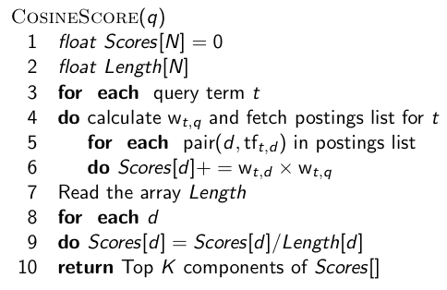
Computing the cosine score (unormalized)
Stores the scores
Stores the Length of each document
Dot product of q and d_{j}
Normalise scores by the document vector length
‹#›

Slide 24
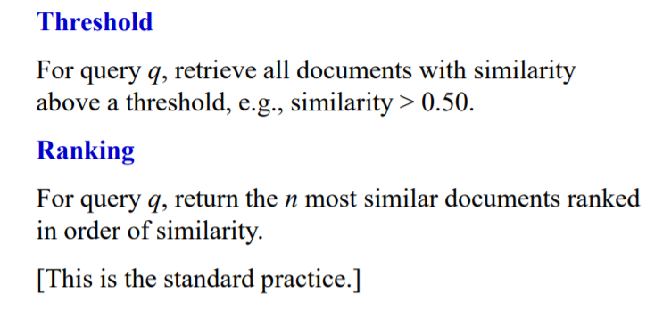
Simple Uses of Vector Similarity in Information Retrieval

Slide 25
Take-away today
Ranking search results: why it is important (as opposed to just presenting a set of unordered Boolean results)
Term frequency: This is a key ingredient for ranking.
Tf-idf ranking: best known traditional ranking scheme
Vector space model: One of the most important formal models for information retrieval (along with Boolean and probabilistic models)
‹#›

Slide 26
Scoring, Term Weighting, and the Vector Space Model
Dr Georgina Cosma

